Slide 1



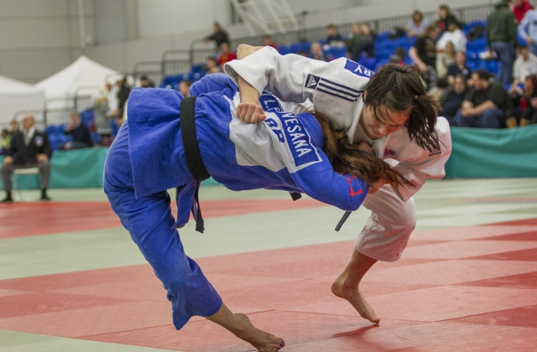
Likelihood of Competition Success by Judo Athletes from Accredited Clubs
Nick Fletcher & Dr Mike Callan
Anglia Ruskin University
Introducton
Discussion
Clubmark is Sport England’s Accreditation scheme for sports club’s who work with children and young people.
Clubmark Accreditation aims to support the development of Judo clubs and recognize them for being safe, effective and child friendly.
Clubmark has four key areas
Coaches and volunteers
Good practice and Child Protection
Knowing your club and its community
The playing program - providing opportunities for members to attend competitions
Accredited Clubmark Judo clubs won 28% of bronze medals, 40% of silver medals and 31% of gold medals at the Pre Cadet, Cadet and Junior British Championships 2013.
Did Accredited Clubmark Judo clubs win medals because they are Accredited or is that accreditation incidental to their medal winning success.
The more Accredited Judo clubs that occupy places in the highest medal winning positions, the stronger the argument becomes that Accreditation is a significant factor. The three Judo clubs who finished in first, second and third places in the medal table at the Pre Cadet, Cadet and Junior British Championships 2013 were all Accredited Clubs.
2013 British Championships for Juniors
Pinewood Judo Club an Accredited club were top of the medal table at the Pre Cadet, Cadet and Junior British Championships 2013. Pinewood have been a highly successful medal winning Judo club for decades and their consistent success pre dates the introduction of Clubmark Accreditation by many years. It is safe to conclude that Pinewood’s competition success is not a direct result of Accreditation. However, is it the case that Pinewood have been meeting Accreditation requirements for years in that they are well organised, well structured and have a strong playing program, prior to such attributes being categorised as Accreditation criteria.
Objective
To establish if Judo players are more likely to win a British Championship medal if they are a member of an Accredited Clubmark Judo club
Of the 908 British Judo Association member Clubs only 13% are Accredited Clubmark Judo clubs.
Only 13% of all British Judo Association clubs are Accredited Clubmark Judo clubs, yet those 13% of Judo clubs won 30% of the medals at the Pre Cadet, Cadet and Junior British Championships 2013.
The benefits of Accreditation with Clubmark are frequently questioned and if there is an identifiable medal winning benefit it may help to promote the scheme.
Conclusion
This research provides a strong indication that an Accredited Clubmark Judo Club that is is more likely to achieve medal winning success at the Pre Cadet, Cadet and Junior British Championships than non accredited Judo Clubs.
References
British Judo Association, 2012. Clubmark.[online] Available at: <www.britishjudo.org.uk/clubmark> [Accessed 9 May 2013].
British Jddo Association, 2013. Results.[online] Available at <www.britishjudo.org.uk/results> [Accessed 9 May 2013].

